Slide 1
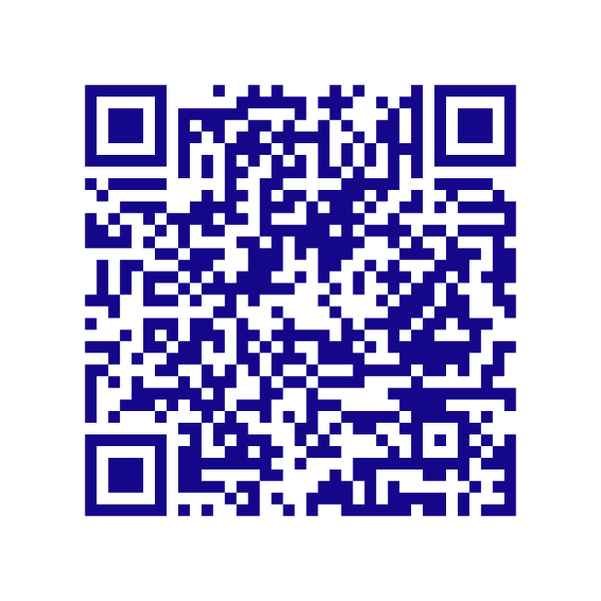


SATISFACTION SURVEY
28 & 29 April 2026
| Marseille, FRANCE
Scan me
BLUE ECOMATCH EVENT

